Slide 1
Imagery
Denotation v. Connotation

Slide 2
What is imagery?
Imagery is the words used to “jazz up” an otherwise boring description in a text
The words used to create a specific “word picture” in the mind of the reader in order to make sure that the reader has the impression that the writer intended

Slide 3
How do writers use imagery?
Imagery is often developed through FIGURATIVE LANGUAGE. You’ve been learning about figurative language since you were in elementary school, most likely. These include:
Metaphors
Similes
Hyperbole
Personification
Alliteration
Onomatopoeia

Slide 4
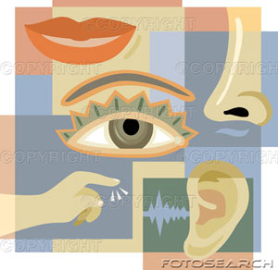
Descriptive Language Includes:
Use of vivid words that address the five senses
Examples:
bright/ shining (sight)
spicy/ slurping (taste)
booming/ rustling (hearing)
prickly/ silky (touch)
putrid/ fresh (smell)

Slide 5
Some terms
Diction: the specific WORD CHOICE that an author uses to create a certain impression For example: slurping instead of eating in— The girl sat, slurping her pasta.
Denotation: the dictionary definition of a word
Connotation: the impression that a word creates in the reader’s mind—even if two words have the same dictionary definition.

Slide 6
Denotation v. Connotation
Eating v. Devouring “The girl ate her food.” v. “The girl devoured her food.”
Eating and devouring mean the same thing in these sentences (denotation), but devouring has a different connotation than devouring, and implies that the girl was very hungry and ate her food very quickly.
“Devoured” provides a clearer description than “ate” in this case.
DURING THE FOLLOWING ACTIVITY, YOU’LL EXPLAIN THE AUTHOR’S CONNOTATION/WORD CHOICE (DICTION) DECISIONS FROM FAMOUS BOOKS.

