Slide 1
Using quotes in writing
Quote weaving guide

Slide 2
What is the purpose of textual evidence?
When analyzing a piece of literature, your job is to make interpretive claims based on the evidence that you see within the text itself.
While you read, you naturally form impressions about the author’s intention(s) and emerging themes, but your argument is made credible ONLY when you support it with relevant quotes and passages from the text.

Slide 3
A leaky argument?
Your goal in writing a paper should be to create a “watertight argument”—that is, one that does not have “leaky spots” where the reader could argue against what you’re saying… due to a lack of evidence or to faulty evidence.

Slide 4
Let the text speak for itself
The best way to create a “watertight argument” is to use the words of the text, rather than your own summary and guesswork, to further your argument.
Let the text speak for itself! Use the author’s words to prove your point.

Slide 5
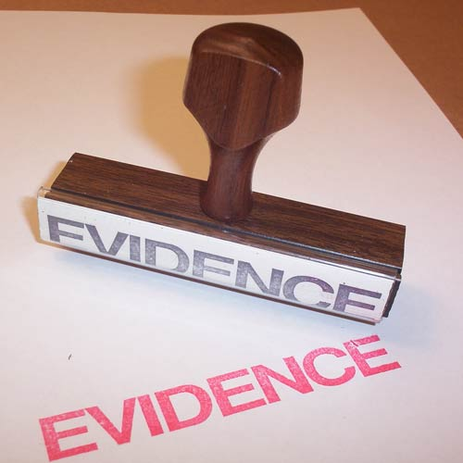
Selecting quotes
It is extremely important (and time-saving) to record or mark important and meaningful passages as you read. That way, when you go back later to select passages to use as evidence in a paper, you have a ready reference (and don’t have to start from scratch).
TWO well-integrated and analyzed quotes per body paragraph will usually provide enough “proof” for the argument that you’re trying to make.

Slide 6
USING quotes
When using quotes, you don’t just “plop” them into your paragraph. Integrating quotes requires that you:
“Set up” your quote
Integrate the quote into a sentence
Analyze your quote and explicitly connect it to the argument that you’re making.

Slide 7
Using quotes: the “set up”
Before adding the quote into your paragraph, you need to establish the argument that you’re trying to make.
In the example I will use to illustrate my point, I will be answering the question: Does Torvald take Nora seriously as a decision-maker in their household?

Slide 8
Using quotes: the “Set Up”
Start with your hypothesis.
Find evidence from the text (i.e. a quote/passage) that weighs in on the issue.
Decide what the evidence illustrates in regard to the hypothesis.
Begin writing about the issue, integrating the quote.

Slide 9
Using quotes: the “Set Up”
Start with your hypothesis.
Find evidence from the text (i.e. a quote/passage) that weighs in on the issue.
Decide what the evidence illustrates in regard to the hypothesis.
Begin writing about the issue, integrating the quote.
My hypothesis/impression is that Torvald does NOT take Nora seriously as a decision-making agent in their household.

Slide 10
Using quotes: the “Set Up”
Start with your hypothesis.
Find evidence from the text (i.e. a quote/passage) that weighs in on the issue.
Decide what the evidence illustrates in regard to the hypothesis.
Begin writing about the issue, integrating the quote.
EVIDENCE:
Torvald calls Nora demeaning nicknames, such as “sky lark” and “spendthrift.”
Nora must ask for money from Torvald, and must justify why she wants it from him in order to earn it.

Slide 11
Using quotes: the “Set Up”
Start with your hypothesis.
Find evidence from the text (i.e. a quote/passage) that weighs in on the issue.
Decide what the evidence illustrates in regard to the hypothesis.
Begin writing about the issue, integrating the quote.
The evidence that I’ve found indicates that he thinks of Nora like a child. He uses the nicknames to emphasize that he doesn’t consider her to be his equal. He holds the power in their relationship, and Nora must prove her case to him before he relinquishes money to her. He holds money over her head, and she needs to prove that she needs it for a “good reason.”

Slide 12
Using quotes: the “Set Up”
Start with your hypothesis.
Find evidence from the text (i.e. a quote/passage) that weighs in on the issue.
Decide what the evidence illustrates in regard to the hypothesis.
Begin writing about the issue, integrating the quote.
The evidence that I’ve found indicates that he thinks of Nora like a child. He uses the nicknames to emphasize that he doesn’t consider her to be his equal. He holds the power in their relationship, and Nora must prove her case to him before he relinquishes money to her. He holds money over her head, and she needs to prove that she needs it for a “good reason.”

